Slide 1
K-means Clustering

Slide 2
Introduction
K-means clustering is an unsupervised machine learning algorithm used to group data into K distinct clusters based on similarity.
You choose a number K, and the algorithm divides your data into K groups such that:
Points in the same cluster are similar
Points in different clusters are dissimilar

Slide 3
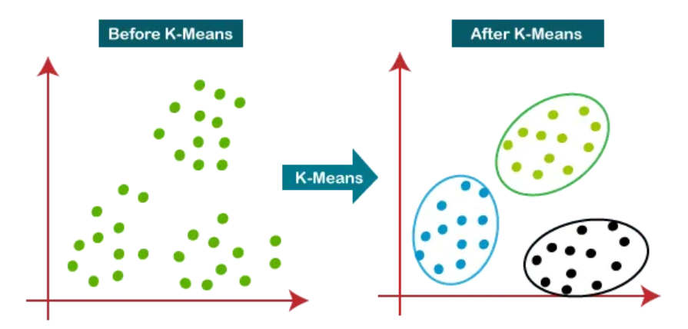
K-means clustering

Slide 4
K-means working principle
Choose K Decide how many clusters you want.
Initialize centroids Randomly pick K points as cluster centers (centroids).
Assign points to clusters Each data point is assigned to the nearest centroid (usually using Euclidean distance).
Update centroids Recompute the centroid of each cluster as the mean of all points in that cluster.
Repeat Keep repeating steps 3 and 4 until:
Centroids stop changing, or
Maximum iterations are reached

Slide 5
K-means clustering – working principle
Assume k = 2 (two clusters)
Assign two cluster centers
Compute distance between each data point and the cluster centers
Assign data points to the closest cluster centers.

Slide 6
K-means clustering – working principle
Recompute cluster centers as average of all points in a cluster.
Assign data points to new cluster centers

Slide 7
K-means clustering – working principle
Recompute cluster centers as average of all points in a cluster.
Assign data points to new cluster centers

